Slide 1
Software Requirements, Analysis and Specification for Airline Flight Booking System
Professor Obinna Kalu
Team members : -
Eshetu Abebe
Jean Charles Jean Chrisner
Nigus Kidane
Yigermal Fantaye
November 2018

Slide 2
Contents
Introduction
High Level System Architecture
Stakeholders
Main Use Cases
Sequence Diagram
Class Diagram

Slide 3
Introduction
Now a days online flight booking for airline travel has been increasingly popular and more people are flying than ever.
Easy online ticket purchase system is one of the major contributors in the increase of the passengers using air travel.
In order to have a market share in this booming market an imaginary company name X is seeking for an online Flight Booking System.

Slide 4
Introduction cont'd
To solve this problem we plane to design and implement a working online Flight Booking System (FBS) application that allow users.
To view available flights
To book a flight.
To check Reservation
Back-office features - provided for authorized person for system administration purpose.

Slide 5
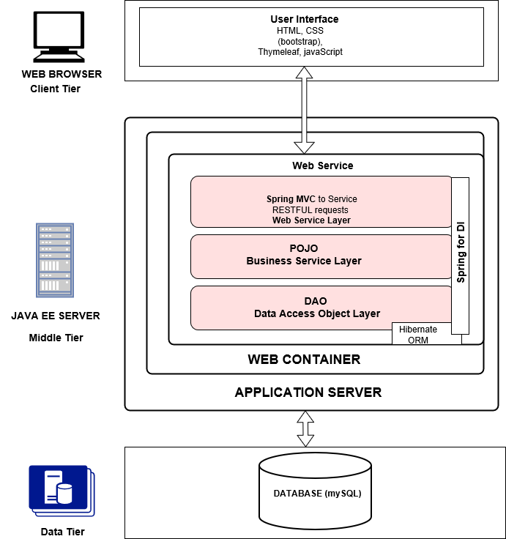
High Level System Architecture

Slide 6
Stakeholders
Name | Description | Responsibilities
Admins | Admins can add/delete/update a flight schedule, Airplane, Airline | Admins are responsible for adding, deleting and updating a flight schedule, Airplane and Airline
Passenger | Passengers can book flight, view available flights and check Reservation | Passengers are responsible to book a flight, view a list of flights and check reservation.
Developers | Developers develop a system on the basis of given document | Developers are responsible for the design and implement system feature, receive all feedback and then for fixing the bug. They must maintain the system availability.
Testers | Tester use jUnit tool to test system or integration | Testers are responsible for integration testing.

Slide 7
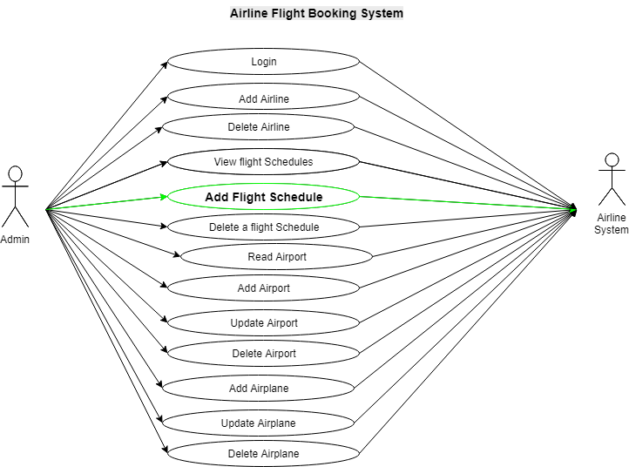
Main Use cases

Slide 8
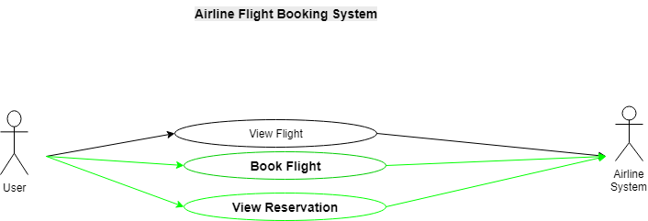
Main Use cases.. cont'd

Slide 9
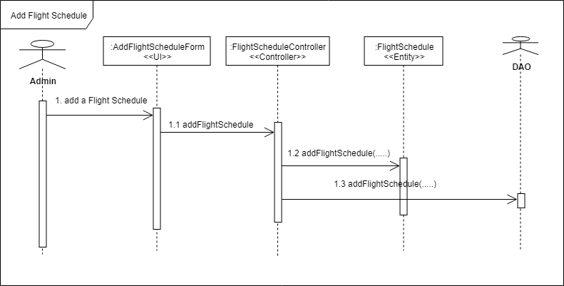
Sequence Diagram

Slide 10
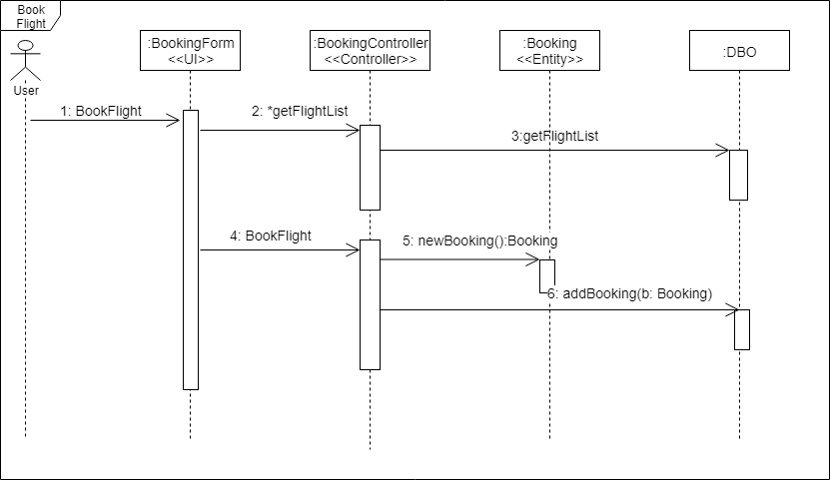
Sequence Diagram.. cont'd

Slide 11
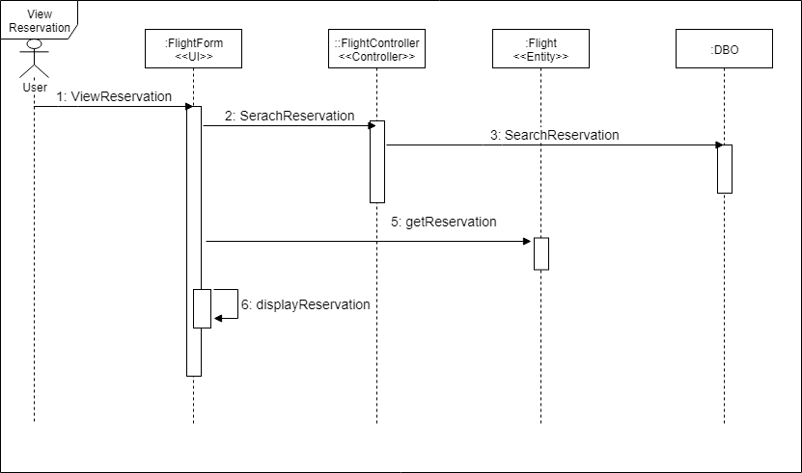
Sequence Diagram.. cont'd

Slide 12
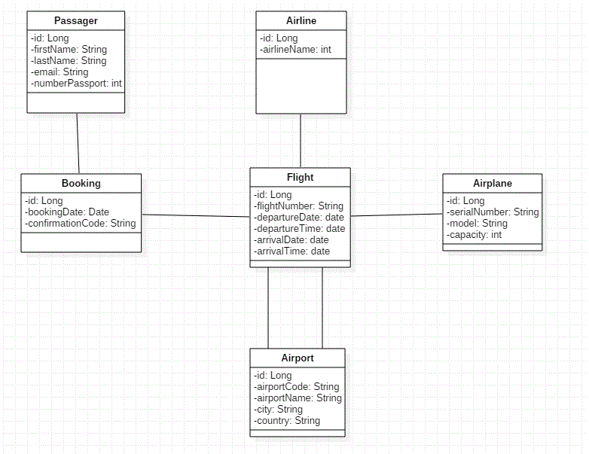
Class Diagram

